Slide 1
On-chain and off-chain data
Chapter 6:

Slide 2
To do for today
READ Chapters 1-5
More information on best practices for smart contract development
Strings (infinite gas) – byte32
Loops (infinite gas)
Large structs
Database is outside the SC (offchain and onchain)
Lets go back to chapter 1 and understand
Lets run the blind auction smart contract and explore the code.
Be creative, think, imagine, grow, explore,…think of words different than my function, roles different than what proposed. Play out the scenarios!
At this point you want to link your working smart contract to web3 app.js. Take a look at how ballot-dapp does it.
The focus here is on app.js that link every function of the interface to a function on the smart contract! Check it out.

Slide 3
Web UI of blind auction
Design of web UI guided
by Remix UI
I cannot understate the importance
of this approach.
UI of blind auction on Remix IDE

Slide 5
Chapter 1

Slide 6
Solidity program for hashing: Keccak Hash
pragma ­­solidity >=0.4.22 <=0.6.0;
contract Khash {
bytes32 public hashedValue;
function hashMe( uint value1, bytes32 password) public
{
hashedValue = keccak256(abi.encodePacked(value1, password));
}
}​
Why do you need a password?

Slide 7
Application of hashing : Blind auction
PROBLEM STATEMENT:
A beneficiary plans a blind auction for a piece of art-work.
There may be many pieces to be auctioned off, but for this problem, you’ll consider only one; you can always add others after this piece is sold.
The beneficiary controls the various stages of the auction, {Init, Bidding, Reveal, Done}.
After initiation by the beneficiary, the bidders bid one bid at a time during the Bidding phase, providing their bids securely and privately.
Others, including the beneficiary, cannot see what each bid is.
After a while, the beneficiary advances the stage to the Reveal phase. Now bidders openly send their bids, and the beneficiary opens the bids and identifies the highest bidder and highest bid.
The beneficiary ends the auction by advancing the stage to Done, at which time the auction ends.
The highest bid value is transferred to the beneficiary account.
Nonwinner bidders can withdraw their deposits, and the winning bidder is returned the balance of their deposit.

Slide 8
Design first
Let’s draw the use case diagram: BlindAuction-Dapp use case diagram.
It is not shown in the book.
Let’s discuss how to include security and privacy issues in your term project. These should be integral part of your project. Without it there is no trust !

Slide 9
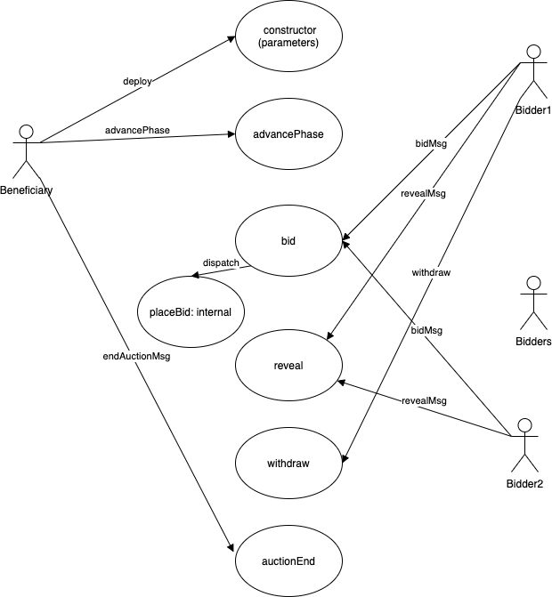
Design diagram 1:
Use case diagram
for blind auction

Slide 10
Design diagram 2 and 3: Finite state machine and contract diagram

Slide 11
Elements of the smart contract
Data elements (listing 5.3)
Modifiers (listing 5.4)
Functions (listing 5.5)

Slide 12
Use the design representation to develop the data structures, modifiers and functions; Data in the listing 5.3, listing 5.4
pragma solidity >=0.4.21 <0.6.0;
contract BlindAuction {
struct Bid {
bytes32 blindedBid;
uint deposit;
}
// state will be set by beneficiary
enum Phase {Init, Bidding, Reveal, Done}
Phase public state = Phase.Init;
address payable beneficiary; //owner
mapping(address => Bid) bids;
address public highestBidder;
uint public highestBid = 0;
mapping(address => uint) depositReturns;
/modifiers
modifier validPhase(Phase reqPhase)
{ require(state == reqPhase);
_;
}
modifier onlyBeneficiary()
{ require(msg.sender == beneficiary);
_;
}

Slide 13
Privacy and security aspects (1)
How do you implement security and privacy? In this case, how do you make the bid private and secure?
The Keccak hash for the integer value (uint) 20, for example, is the same whether you’re on the Earth, Moon, or Mars, in Lagos (Nigeria), or New York (United States), as follows:
0xce6d7b5282bd9a3661ae061feed1dbda4e52ab073b1f9285be6e155d9c38d4ec
This 32-byte hash value might look like gibberish to you, but a brute-force attack with knowledge of the approximate context and value of the auction item could easily decipher the bid value if so desired.
So how do you secure it from such an attack?
You can use a nonce or a secret password as the second parameter. This secret is like a personal identification number for your debit card.

Slide 14
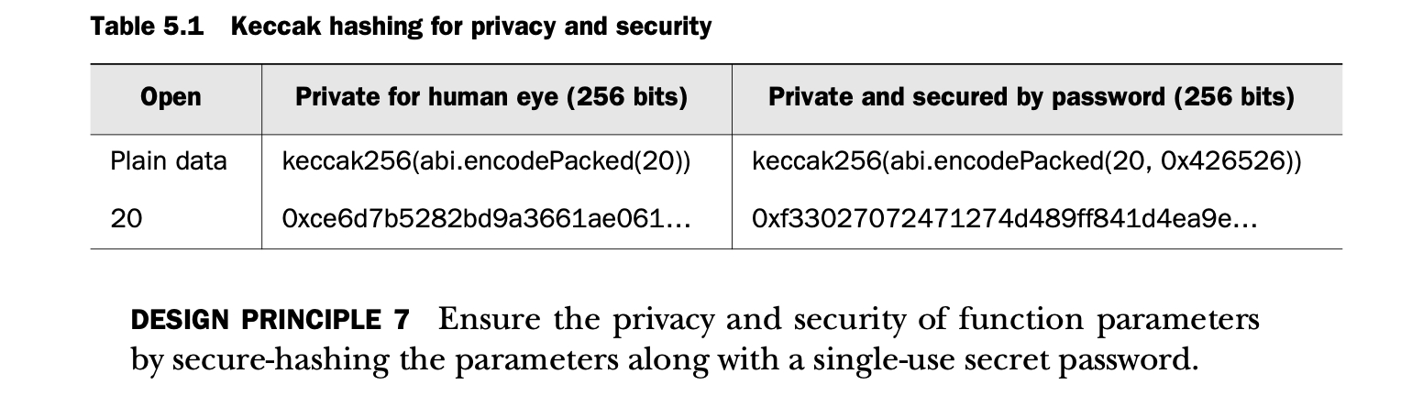
Privacy and security aspects (2)
The first column is the plain data value, 20 (open); the second column is the Keccak256 hash of 20 (private but not secure); and the third column is the Keccak256 hash of 20 and the password (in this case, 0x426526) of choice from the decentralized participant (private and secure). In the table, the abi.encodePacked() function of Solidity creates a byte form of parameters before Keccak hashing.

Slide 15
On to Remix to test the blind auction function.
Password
0x4265260000000000000000000000000000000000000000000000000000000000
Blinded bid for 20
0xf33027072471274d489ff841d4ea9e7e959a95c4d57d5f4f9c8541d474cb817a
Blinded bid for 30
0xfaa88b88830698a2f37dd0fa4acbc258e126bc785f1407ba9824f408a905d784

Slide 16
Chapter 6
○ Exploring different kinds of on-chain data: blocks, transactions, receipts, and state
○ Defining, emitting, and logging events
○ Accessing event logs from transaction receipts to support Dapp operations
○ Designing and developing Dapps with on-chain and off-chain data
○ Demonstrating on-chain and off-chain data using ASK and blind auction Dapps

Slide 17
Onchain and offchain data
This is it. This is what distinguishes blockchain application development from that of non-blockchain applications: on-chain data.
Do you wonder where the data associated with a Dapp is stored?
Some are stored on the blockchain infrastructure (on-chain), and others in traditional databases and files (off-chain).

Slide 18
What is on-chain data?
In a traditional system, the results of function executions in an application are persisted in a local filesystem or a central database. A blockchain application stores the following on the blockchain node (on-chain):
○ Transactions executed and confirmed ○ Results of smart contract function execution ○ State changes (changes in storage variable values)
○ Logs of events emitted
These data are stored in designated data structures on a blockchain node and propagated to other stakeholder nodes as specified by a blockchain protocol.
DEFINITION On-chain data is a set of information generated by transactions ini- tiated by blockchain-based applications and the items used during blockchain materialization. Most of this data is stored in a block and its header.

Slide 19
Figure 6.1 traditional application vs. blockchain Dapp with on-chain and off-chain data

Slide 21
On-chain data
○ The blockchain header (6A) stores the attributes of the block.
○ Transactions (6B) store the details of the Txs recorded in the block.
○ Receipts (6C) store the execution results of Txs recorded in the block. Every transaction has a receipt; the 1:1 relationship in figure 6.2 depicts this fact.
○ A composite global state (6D) stores all the data values or current state of the smart contract accounts and other regular accounts on the blockchain and is updated when Txs that use them are confirmed.

Slide 22
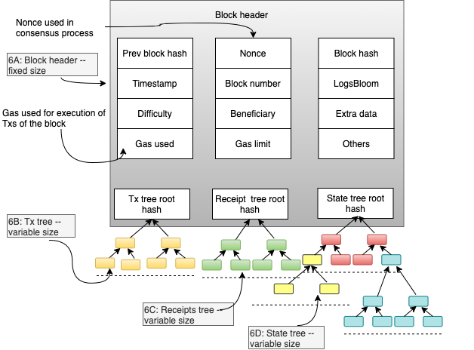

Slide 23
Blind auction with events

Slide 24
Blind auction with events
Final exam question?
What are events?
How do you define them?
How do you invoke?
Where are they “stored”? How do you access emitted events?
How do you utilize the emitted events /notifications? For further analytics, computation and announcements?

Slide 25
On-chain events
Block header, Txs, receipts, and state storage— form the majority of the on-chain data.
This data plays a significant role in ensuring the robustness and security of the blockchain, and also provides proof of existence for transactions and events.
You can access the information stored on the blockchain to support operations at the application level.
The kinds of on-chain data are strictly controlled by the blockchain protocol, with the actual data values being determined by the Txs originating from the applications. You must be aware of this limitation when designing your blockchain-based systems.
To illustrate these concepts, we’ll explore an improved version of the blind auction application.
But before that let’s understand “Events”

Slide 26
Events?
Let’s begin by considering the following:
○ What an event is
○ How to define an event
○ How to emit an event
○ How to use event logs in the Tx receipts to provide notifications to the user via the UI

Slide 27
What are events?
Events are notifications that can be emitted from functions to indicate the presence of a condition or flag during a smart contract function’s execution.
Solidity provides features to define and emit an event with and without parameters.
Events are logged on-chain, in the receipt tree, and can be accessed by their names.
Of course, events represent application-specific “events” or “situations” that may need participants attention and actions.

Slide 28
How to define an event?
Here is the syntax for an event definition:
event NameOfEvent (parameters);
Event names in Solidity begin with an uppercase letter and then use camel case. There can be three parameters at most.
This limitation is set by Solidity to avoid overloading the chain and to enable efficient management of the event logs. Here’s an example of an event definition for the blind auction smart contract introduced in chapter 5:
event AuctionEnded(address winner, uint highestBid);
You can also define events without any parameters by specifying them for different phases of the blind auction (here, Bidding and Reveal):
event BiddingStarted();
event RevealStarted();

Slide 29
Where do you define an event in an SC?
You can define an event anywhere in the smart contract code before you use it.
Still, it’s a good idea to set aside a standard location to define the events in your design and coding so that they can be easily identified during the development and code review process.
You can define events in the smart contract right after the type and variable declarations.

Slide 30
Emitting an event
The emit call triggers an event:
emit BiddingStarted();
emit RevealStarted();
Now let’s design the blind auction contract with events.
These can have meaningful parameters too! Emit BiddingStarted (paramters, “Bidding Started”);

Slide 31
Contract diagram with events

Slide 32
On to listing 6.1 for Remix exploration.

Slide 33
Khash for 1 to 9 with 0x426526 as OTP
1. 0xeef3620c18bdc1beca6224de9c623311d384a20fc9e6e958d393e16b74214ebe
2. 0x54e5698906dca642811eb2f3a357ebfdc587856bb3208f7bca6a502cadd7157a
3. 0x74bbb8fdcb48d6f82df6e9067fd9633fff4cab1103f0d5cb8b4de7214cbdcea1
4. 0x23b7317bad9be591ebd1a4cb60fbc61cd5aa06e2897371ec35673fa10afdfbbf 5. 0xa880ced0bec614fc69ea1e83f5305d6b5d609a06097e6538d5943fd1e2e0e6a0 6. 0xf97658c48dd01c7fd7072cd7f2ac355d43dfe7036a1efd5a52e5dc4a60773ab7 7. 0x468ee8442496706c958855a4a8efef82343504ee280c002fb9d61569f8ecd21a 8. 0x86977eeb7686f36f6a96f7976522bb1bc5040f8acc958b7ec8e9dfd25936d8de 9. 0xe4e379235e9af3d8096c9a54651d7aa666f8de66f93f01f0d65f20edeca77bda
ᐧ

